Slide 1
EVENTIFY – Event Management Website
College Web Development Project
Technologies Used:
• HTML
• CSS
Created By: Ashmeet Kaur,2510998513,AIFT-1A
Purpose:
• A modern event management website designed for college assignment

Slide 2
Navigation Bar (Navbar)
• Appears on every page for consistency
• Menu items: Home, About, Services, Contact, Reviews
• Opens each page in the same tab
• Improves usability and navigation flow

Slide 3
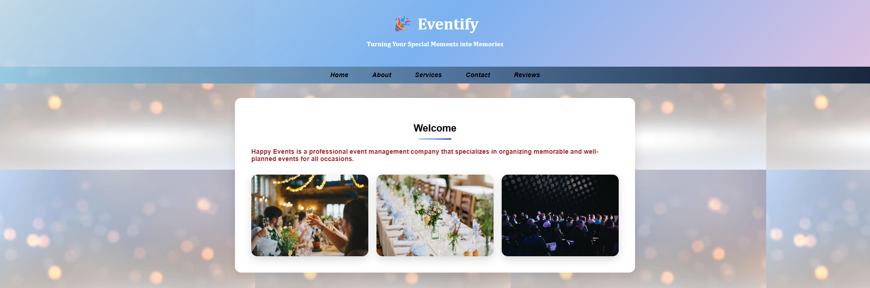
Home Page (Welcome Section)
• Acts as the landing page of the website
• Introduces Eventify and its purpose
• Includes event images like birthdays, weddings, and corporate events
• Creates a strong first impression

Slide 4
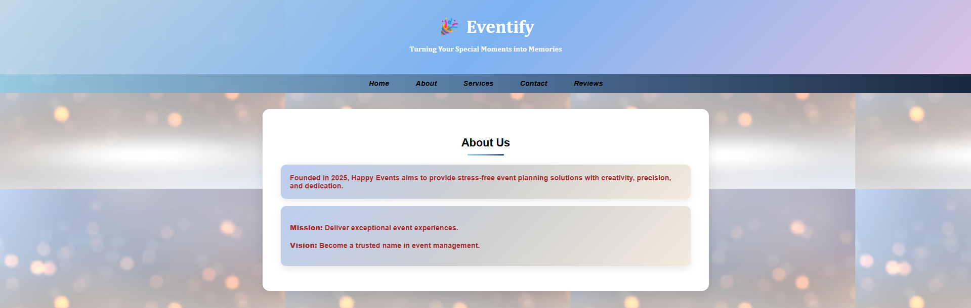
About Us Page
• Provides background information about Eventify
• Mentions year of establishment
• Displays mission and vision clearly
• Helps build trust with users

Slide 5
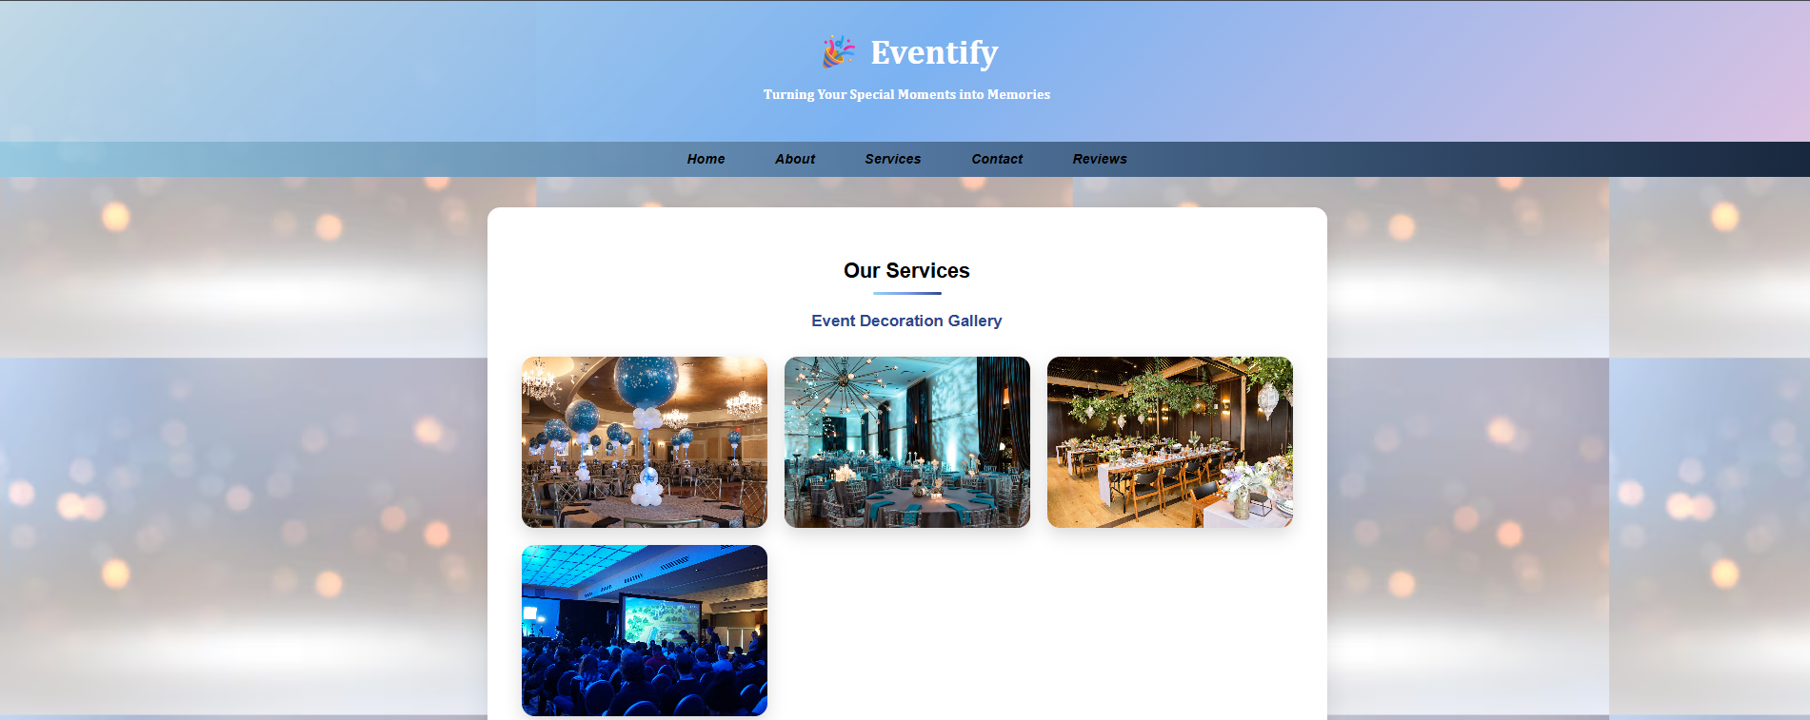
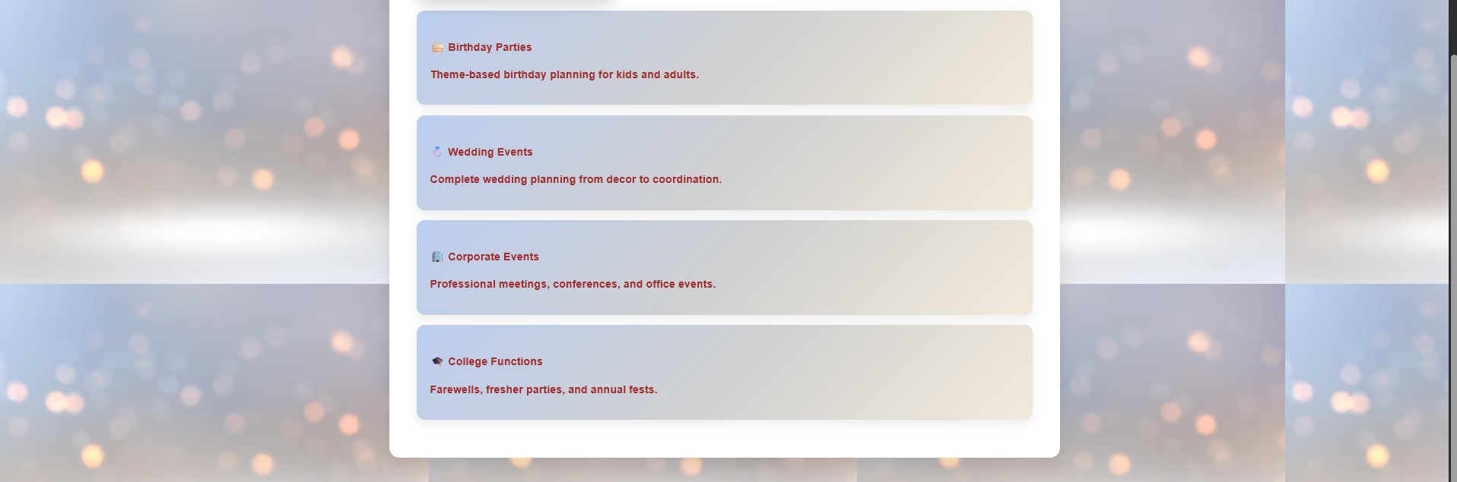
Services Page
• Displays types of events managed by Eventify
• Includes Birthday, Wedding, Corporate and College events
• Contains an event decoration image gallery
• Uses card-based layout for clarity

Slide 6
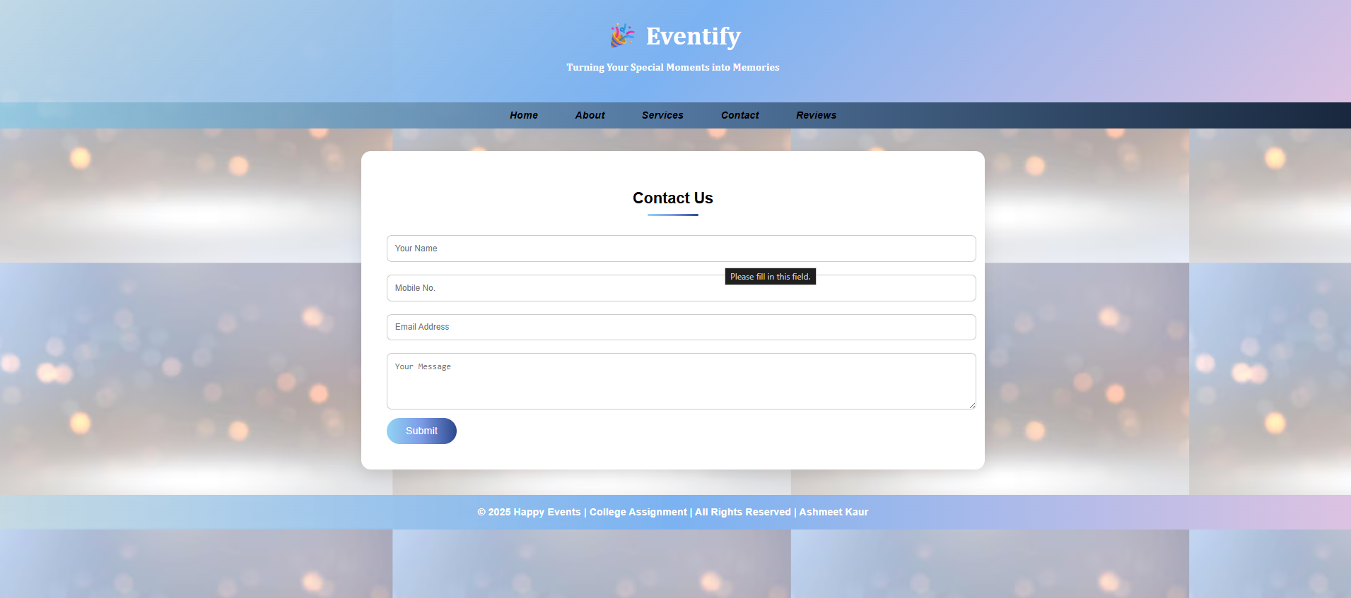
Contact Page
• Contains a professional contact form
• Fields: Name, Mobile Number, Email, Message
• Allows users to reach out easily
• Validations improve data accuracy

Slide 7
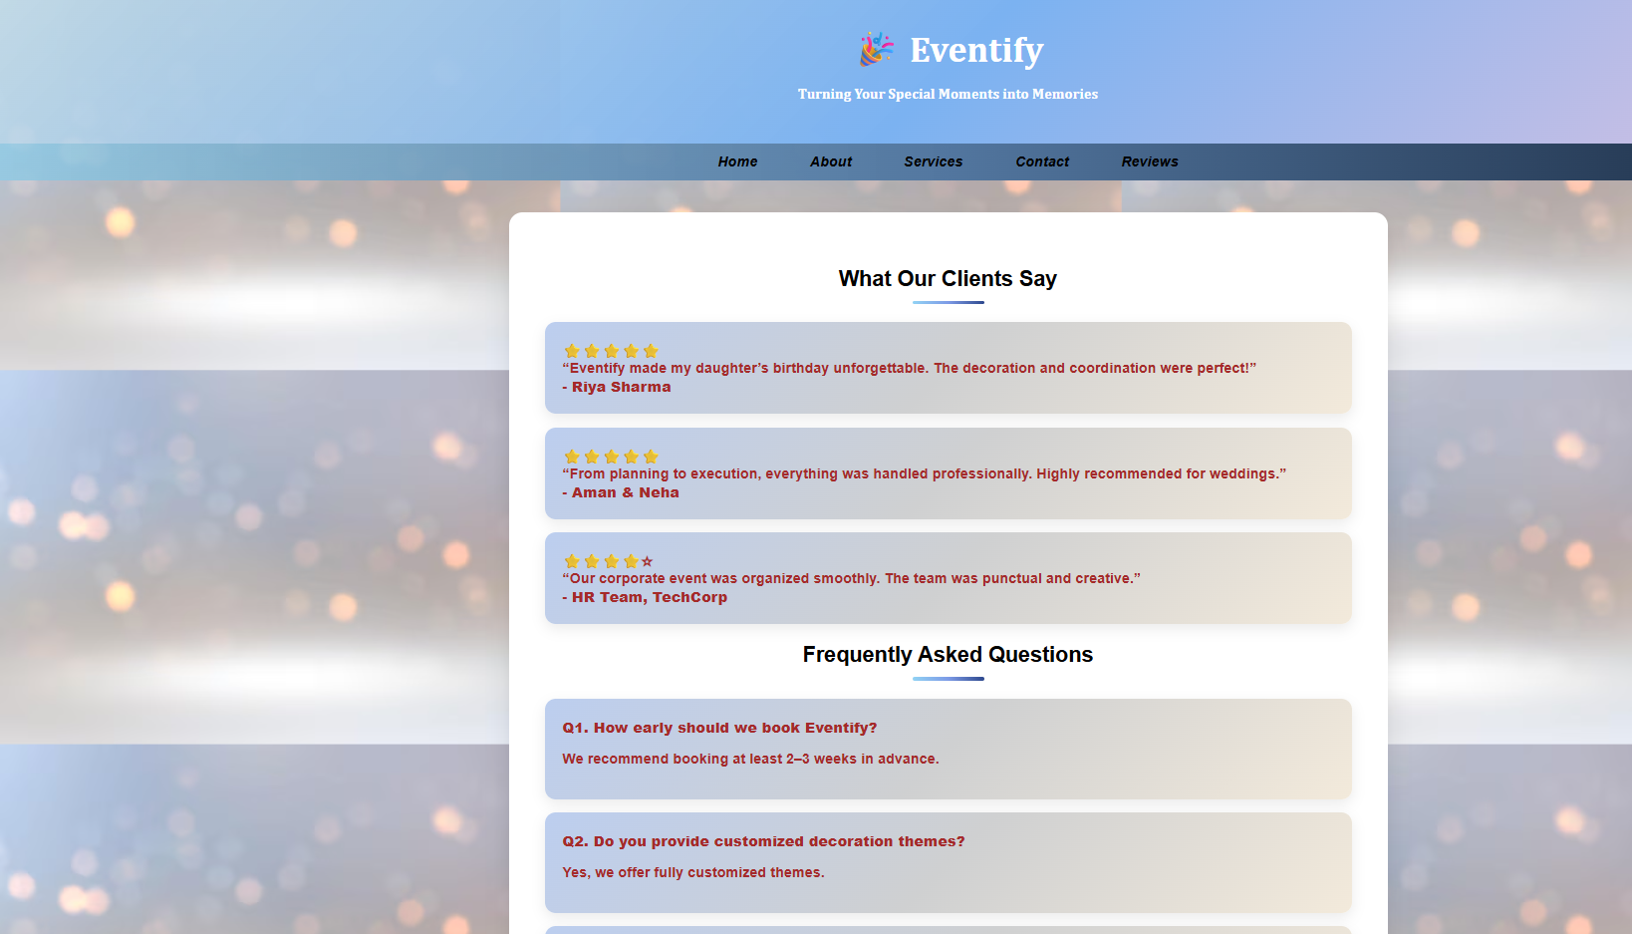
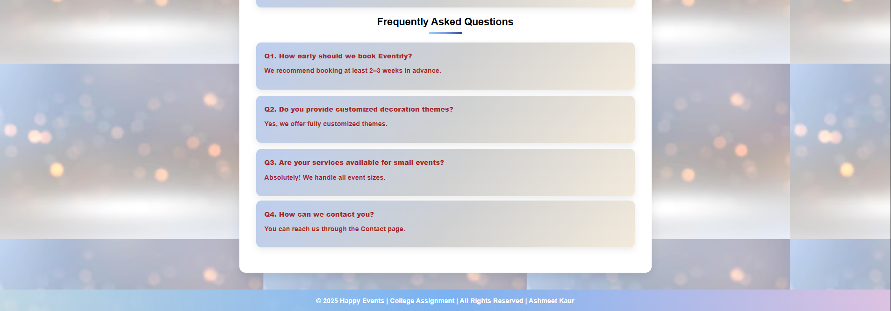
Reviews & FAQ Page
• Displays customer feedback and ratings
• Builds credibility using real testimonials
• FAQ section answers common queries
• Enhances user confidence

Slide 8
Footer Section
• Appears at the bottom of every page
• Displays copyright information
• Text: © 2025 Happy Events | College Assignment
• Provides professional closure

Slide 9
Styling & Design
• Uses external CSS file for styling
• Gradient backgrounds for modern look
• Smooth hover effects and animations
• Responsive layout for all screen sizes

Slide 10
Body Styling (Global Styles)
• Sets default font family for the entire website
• Uses gradient background for modern appearance
• Background image enhances visual appeal
• Bold text improves readability

Slide 11
Header Styling
• Uses linear-gradient background for premium look
• Padding adds spacing around content
• Center-aligned text improves symmetry
• Serif font gives elegant appearance

Slide 12
Navigation Bar Styling
• Gradient background differentiates navbar section
• Inline links styled as rounded buttons
• Hover effects improve user interaction
• Same navbar reused on all pages for consistency

Slide 13
Section Styling
• White background improves content focus
• Border-radius gives smooth card-like appearance
• Box-shadow creates depth effect
• Fade-in animation enhances user experience

Slide 14
Card Component Styling
• Cards used for services, reviews, FAQs
• Gradient background adds visual richness
• Hover transform effect creates interactivity
• Reusable component across pages

Slide 15
Image Gallery Styling
• CSS Grid used for responsive layout
• Images automatically adjust for screen size
• Hover scale animation adds dynamic feel
• Box-shadow highlights images

Slide 16
Form Styling
• Inputs styled with padding and rounded corners
• Full-width fields improve usability
• Border styling ensures clean UI
• Button gradient matches website theme

Slide 17
Footer Styling
• Gradient background maintains theme consistency
• Center-aligned text for neat appearance
• Footer appears on every page
• Provides professional closure

Slide 18
CSS Animations
• Fade-in animation applied to sections
• Improves visual smoothness during page load
• Uses keyframes for clean animation control
• Enhances overall user experience

Slide 19
CSS Conclusion
• External CSS makes the website modular
• Improves reusability and performance
• Easy to update design without changing HTML
• Suitable for academic and real-world projects

Slide 20
Conclusion
• Multi-page event management website
• Built using only HTML and CSS
• Clean, responsive and visually appealing
• Ideal for first semester college project

